Slide 1
Academic Register and Handling Questions
Effective Presentations Week 3

Slide 2
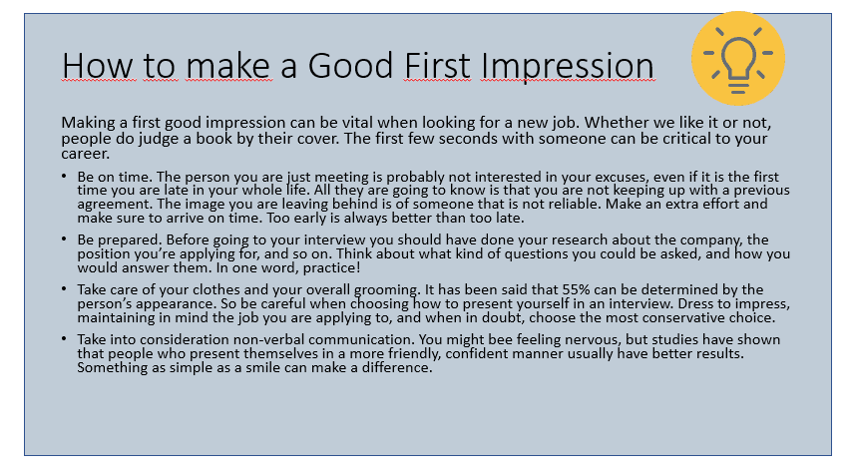
This information is taken from Stella Cooper in her book Better Presentations published in 2018. Except for the last point on non-verbal communication which was taken from Body Language by John Smith published in 2011
Example adapted from: https://24slides.com/presentbetter/bad-powerpoint-examples-you-should-avoid (11/22/21)

Slide 3
How to make a good first impression
Be On Time: Too early is better than too late. (Cooper, 2021)
Dress to Impress: Take care of your clothes and overall grooming. (Ibid)
Be Prepared: Do your research and practice. (Ibid)
Consider Non-Verbal Communication: Confident, friendly body language can make a significant difference (Smith, 2011)

Slide 4
Academic Register
Register is the manner of writing ... specific to a certain domain of communication.
Select the words you use carefully.
Think about the style, tone and approach to writing.
Appropriate for the formal academic domain of communication.
Particularly relevant for writing visual aids
Academic communication can be seen as a ‘conversation’ within specific fields of study.

Slide 5

Why?
The tone of the language is appropriate to your academic community. This tone and style reflects the serious, impersonal attitude reserved for academic discovery and debate.
Communicating internationally
Maintaining ‘distance’ to enable discussion
Maintaining reliability, authority and credibility

Slide 6
Tone and Style
It is important when you write your assignments at Queen Mary that your writing can be, according to Clanchy and Ballard (1992), cited in Jordan (1997, p.244):
‘objective‘ not ‘____________ ‘
‘intellectual‘ not ‘___________ ‘
‘serious‘ not ‘____________ ‘
‘impersonal‘ not ‘__________ ‘
‘formal‘ rather than ‘___________ ‘.
Colloquial
Emotional
Personal
Subjective
Conversational

Slide 7
Tone and Style
It is important when you write your assignments at Queen Mary that your writing can be, according to Clanchy and Ballard (1992), cited in Jordan (1997, p.244):
‘objective‘ not ‘subjective‘
‘intellectual‘ not ‘emotional‘
‘serious‘ not ‘conversational‘
‘impersonal‘ not ‘personal‘
‘formal‘ rather than ‘colloquial‘.

Slide 8
Spoken vs Written English
Spoken
Written
Active voice
Personal pronouns
Colloquial vocabulary
Pronunciation considerations
Speed and pacing a factor
More passive voice
Fewer (if any) personal pronouns
More formal vocabulary
No pronunciation issues so punctuation becomes more important
Structure and organisation

Slide 9

Economy of Expression
Keep writing as CLEAR, DIRECT & SIMPLE as possible
If it’s possible to express an idea in 5 words, why use 15?
Reduce redundancy
Easier for your reader to follow
Meet word count

Slide 10
Economy Of Expression
Poor style: The primary ambition of expressing concepts in an academic fashion is to provide assistance for the audience of the piece in comprehending the information being conveyed in an expeditious and accessible manner.
Better style: Effective academic writing helps readers understand your points quickly and easily.

Slide 11
Task 1 - Reducing redundancy
Here is a short sentence (18 words). It is possible to express the same idea in only 5 words.
See if you can replicate the full meaning of the sentence below using only 5 words.
There are many people in the world who do not have enough money to buy food to eat (18 words)

Slide 12
Reducing redundancy
There are many people in the world who do not have enough money to buy food to eat
The first concept is about money. Think of an adjective that describes a lack of financial resources.

Slide 13
Reducing redundancy
There are many people in the world who do not have enough money to buy food to eat
Poor (adj)
What’s the noun of ‘poor’?

Slide 14
Reducing redundancy
There are many people in the world who do not have enough money to buy food to eat
Poor (adj)
Poverty (n)

Slide 15
Reducing redundancy
There are many people in the world who do not have enough money to buy food to eat
The next concept is about lacking sufficient nutrition. Think of an adjective that describes how you’d feel if you didn’t have enough food

Slide 16
Reducing redundancy
There are many people in the world who do not have enough money to buy food to eat
Hungry (adj)
Now the noun for hungry?

Slide 17
Reducing redundancy
There are many people in the world who do not have enough money to buy food to eat
Hungry (adj)
Hunger (n)

Slide 18
Reducing redundancy
There are many people in the world who do not have enough money to buy food to eat
The final concept is that the effects of poverty and hunger are a global problem
Here you’ll need an adjective or adverb

Slide 19
Reducing redundancy
There are many people in the world who do not have enough money to buy food to eat
Globally / Widespread (adj)

Slide 20
Reducing redundancy
Poverty and hunger are widespread
Poverty and hunger are global problems
(5 / 6 words)
Nominalisation
CLEAR, DIRECT & SIMPLE

Slide 21

Where possible, choose more formal vocabulary
Following review, accuracy was pretty good compared to before.
Following review, accuracy was much improved.
The new regulation has had a really big impact on import capabilities.
The new regulation has had a significant impact on import capabilities.

Slide 22
There are lots and lots of great ideas nowadays.
Currently, there are many impressive / creative / innovative ideas / concepts.
Students get a lot of help from professors
Students receive considerable assistance from professors

Slide 23
Get
A very versatile English verb but it can always be replaced by more formal synonyms:
Receive; earn; retrieve; buy; become;
Understand; achieve; arrive; obtain; reach;
Punish; injure; annoy; arrest; capture; seize;
Hear; discern; distinguish; perceive.
Get

Slide 24
Using Qualifying Words and Phrases - Hedging
American cultural domination is destroying local traditions all over the world.
It is possible that American cultural domination is destroying local traditions all over the world.
Or Arguably, American cultural domination is destroying local traditions all over the world.
Or American cultural domination may be destroying local traditions all over the world.

Slide 25
Linking words and phrases
To add a thought
In addition, again, as well as, furthermore, moreover, etc.
To show an outcome
As a result, consequently, hence, therefore, etc.
To compare
On the other hand, likewise, nevertheless, therefore, however, similarly, etc.
To conclude
Above all, over all, in conclusion, after all, all in all, etc.
To generalize
Generally speaking, usually, in general, etc.
To show order
Firstly, lastly, secondly, finally, in the meantime, meanwhile, afterward, later, etc.
To restate
In other words, as mentioned earlier, etc.
To stress something
Specifically, in particular, for instance, especially, etc.

Slide 26
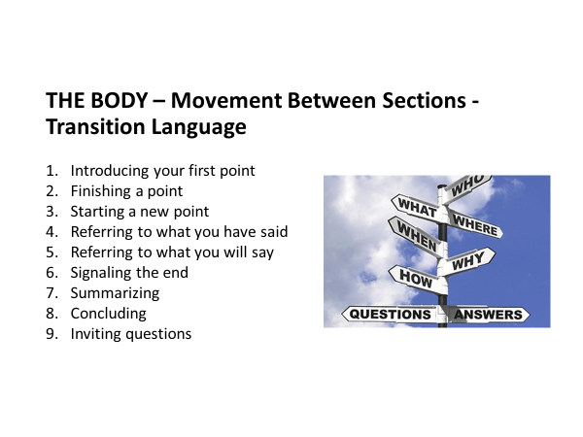

Slide 27

Tips for dealing with questions
The question period often is the part of the talk which influences the audience the most, and where your ability to interact with the audience will be evaluated. Since you can't always predict what you'll be asked, how can you prepare for the questioning?
Best answer is a direct answer – one that address the questions fully and accurately
However – some questions can’t be handled so easily….
Here are some guidelines and tips…

Slide 28
Strategies for dealing with awkward questions
Buy time…
When you get a question, comment on it first. This will give you time to think. Here are some useful expressions to help you do that:
That's a good question
That’s a very interesting / relevant question.
I'm glad you've asked that question.
Seek clarification:
Can I ask what’s behind that question?
Well, what’s your own view?
Why do you ask?

Slide 29
Strategies for dealing with awkward questions
Delay or Defer:
I'm sorry but I don't have that information to hand.
I’m afraid I can’t give you answer off the top of my head. Can I get back to you on that?
I’d like to / I’d need to consult a colleague / a source to be sure, then get back to you
Referral:
I'm afraid I can't answer that but I can direct you to…
I'm not in a position to comment on that but perhaps if you consult…
Let me direct you to Jones (2012) who wrote extensively on X…

Slide 30
Strategies for dealing with awkward questions
Reference back to your thesis/topic:
As I said earlier, …
I think I answered that when I said …
Let me reiterate the key point I was trying to make…
Let me repeat again for clarity the main points from my talk today….
Dismiss as off topic:
I don't see the connection.
I'm sorry, I don’t follow you.
I think that is a very different issue.

Slide 31
Strategies for dealing with awkward questions
‘Simplify and Kill’:
Paraphrase what they're saying into a yes or no question, proceed immediately after they say "yes" or "no“
e.g. How soon will a decision be reached?
Will a decision be reached today? No.
Will a decision be reached soon? Yes.

Slide 32
Task 2 – bringing it all together
Remembering aspects of NVC, including eye contact, delivery – stress, intonation, pace etc, we will take turns handling deliberately awkward questions
What’s the precise population of Finland?
By how many degrees will global temperatures going to rise in the next 5 years?
How long will it be before we have a fully operational colony on Mars?
Can you explain the history of medical developments that made MRI scanning a modern reality?
Why are the direct impacts of globalisation on race relations in major 1st world cities?

